Slide 1
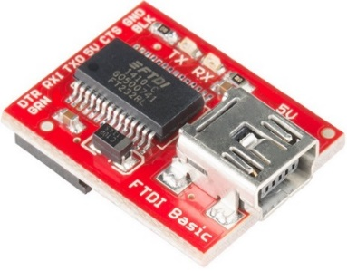

Lecture 2-1 Zybo, FPGA, PicoBlaze and UART Clock
Assignments and handouts
Introduction to Zybo
FPGA Architecture
PicoBlaze – 8-bit Microcontroller
Real-time Clock with RS232 Serial Port (UART Clock)
Zybo Implementation of the UART Clock
Program Zybo with bit stream file only
SparkFun FTDI Basic Breakout – 3.3V
Hyper Terminal Setup
Save a setup
Lab #1 Xilinx Tool Flow and UART Clock in Verilog with PL

Slide 2
Assignments and Handouts
Lab #1 Xilinx Tool Flow, Pins Assignment, UART on Zybo PL
Due by Wednesday, August 11
Homework #1 on Combinational and Sequential Circuits with Verilog
Due by Thursday, August 12
Lecture 2-1 and 2-2
Lab #1 handout and source files
Homework #1handout
problem8homework1UART documents.zip
Four counters project.zip
stopwatch2021summerlNexyA7.zip

Slide 3
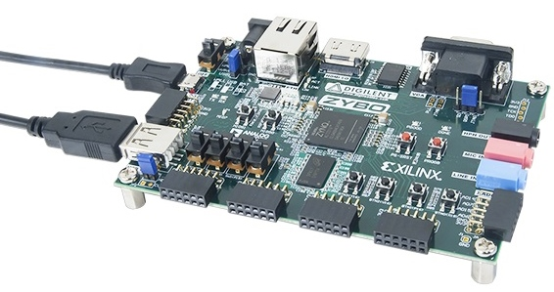
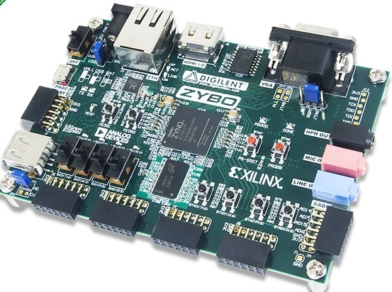
Zybo Zynq-7000 ARM/FPGA SoC Trainer Board
Digilent
$189
Voucher for Xilinx Vivado Design Suite: Design Edition (One full seat, node locked, device-locked to the Zynq-7000 XC7Z010)
4GB microSD card
Micro USB cable
5V 2.5A switching power supply

Slide 4

Resources on the Zybo Board
28,000 logic cells
40 KB Block RAM
80 DSP slices
On-chip dual channel, 12-bit, 1 MSPS analog-to-digital converter (XADC)
650 MHz dual-core Cortex™-A9 processor
On-board JTAG programming and UART to USB converter
DDR3 memory controller with 8 DMA channels
512 MB x32 DDR3 w/ 1050Mbps bandwidth
128 Mb Serial Flash w/ QSPI interface
microSD slot (supports Linux file system)
High-bandwidth peripheral controllers: 1G Ethernet, USB 2.0, SDIO

Slide 5
Resources on the Zybo Board
Low-bandwidth peripheral controller: SPI, UART, I2C
Dual-role (Source/Sink) HDMI port
16-bits per pixel VGA output port
Trimode (1Gbit/100Mbit/10Mbit) Ethernet PHY
OTG USB 2.0 PHY (supports host and device)
External EEPROM (programmed with 48-bit globally unique EUI-48/64™ compatible identifier)
Audio codec with headphone out, microphone and line in jacks
GPIO: 6 pushbuttons, 4 slide switches, 5 LEDs
Six Pmod connectors (1 processor-dedicated, 1 dual analog/digital)

Slide 6
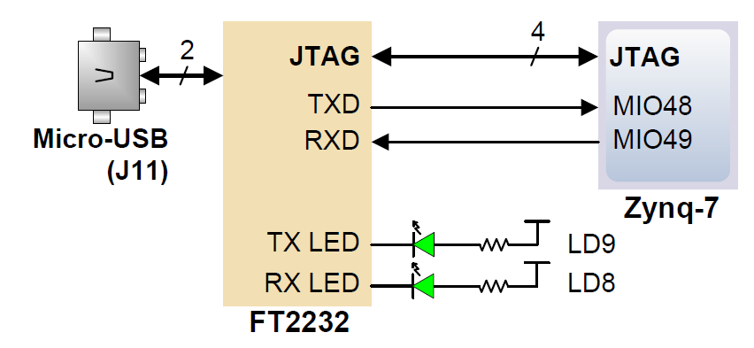

USB-UART Bridge on the Zybo Board
The board definition file takes care of mapping the correct MIO pins to the UART 1 controller and uses the following default protocol parameters: 115200 baud rate, 1 stop bit, no parity, 8-bit character length.
The FT2232HQ is also used as the controller for the Digilent USB-JTAG circuitry, but the USB-UART and USB-JTAG functions behave entirely independent of one another.

Slide 7
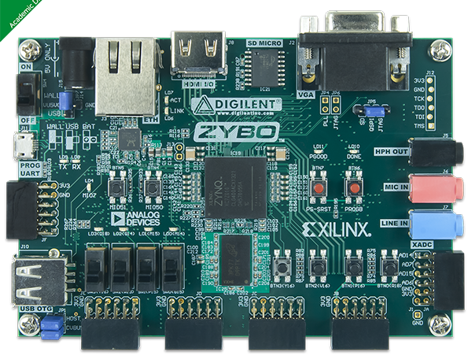
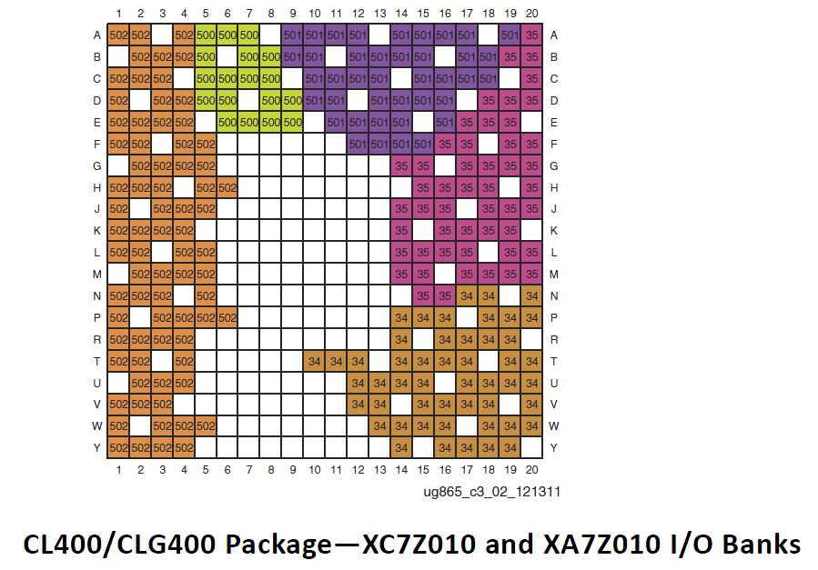
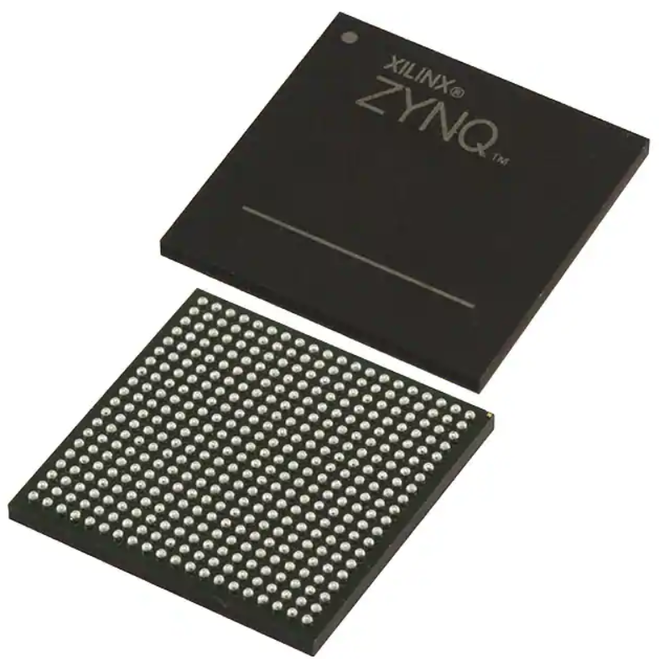
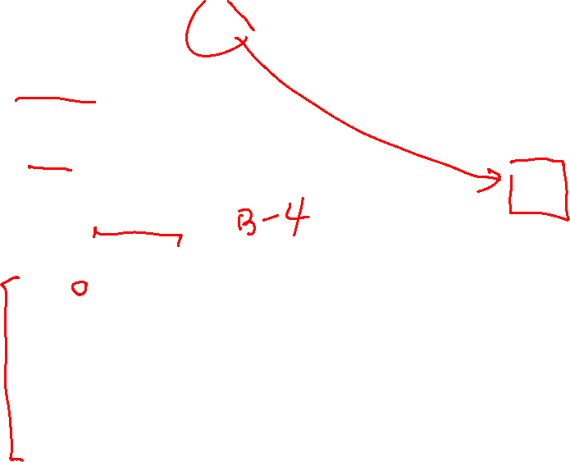
Zynq 7000 Chip on Zybo Board
20x20 Ball Grid Array (BGA package CLG400)
pins are labeled with letters for rows and numbers for columns

Slide 8
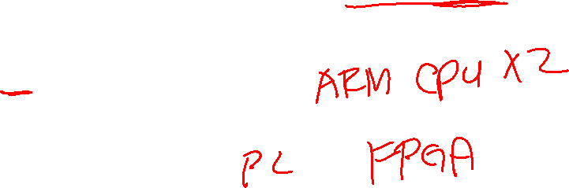
Zynq 7000 Chip on Zybo Board
XC7Z010T-1CLG400 All Programmable SoC ($83.02 at digikey)
The Zynq-7000 AP SoC architecture consists of two major sections
PS: Processing system
Dual ARM Cortex-A9 processor based
Multiple peripherals
Hard silicon core
PL: Programmable logic
Shares the same 7 series programmable logic as
Artix™-based devices: Z-7010, Z-7015, and Z-7020 (high-range I/O banks only)

Slide 9
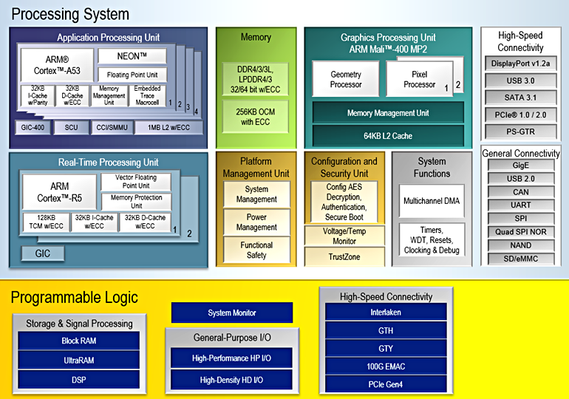
Xilinx SoC XAZU5EV-1SFVC784Q (Jan 2, 2020)
$2,954.46 at Digikey
1.2GHz 64-bit Quad Cortex A53
500 MHz Dual Cortex R5
400MHz MP2 GPU
500 MHz FPGA
256k logic cells
234k flip-flops
117k LUTs
5.1MB block RAM
1,248 DSP Slices
Digikey: https://www.digikey.com/product-detail/en/xilinx-inc/XAZU5EV-1SFVC784Q/122-XAZU5EV-1SFVC784Q-ND/10445682

Slide 10
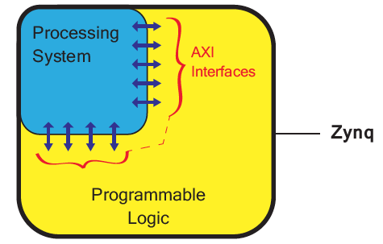
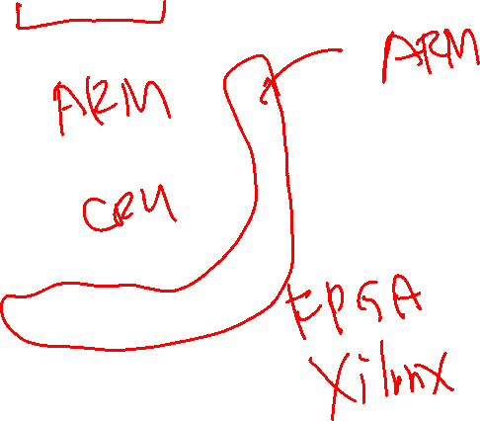
System on a Chip: the Zynq Chip Architecture
The Zynq chips have two separate areas of functionality
The blue area is CPU area for a number of ARM CPUs
The yellow area is FPGA area for Xilinx FPGA
The connection network of AXI interfaces from ARM between the two computing areas
Source: The Zynq Book
© Copyright 2014 Xilinx

Slide 11
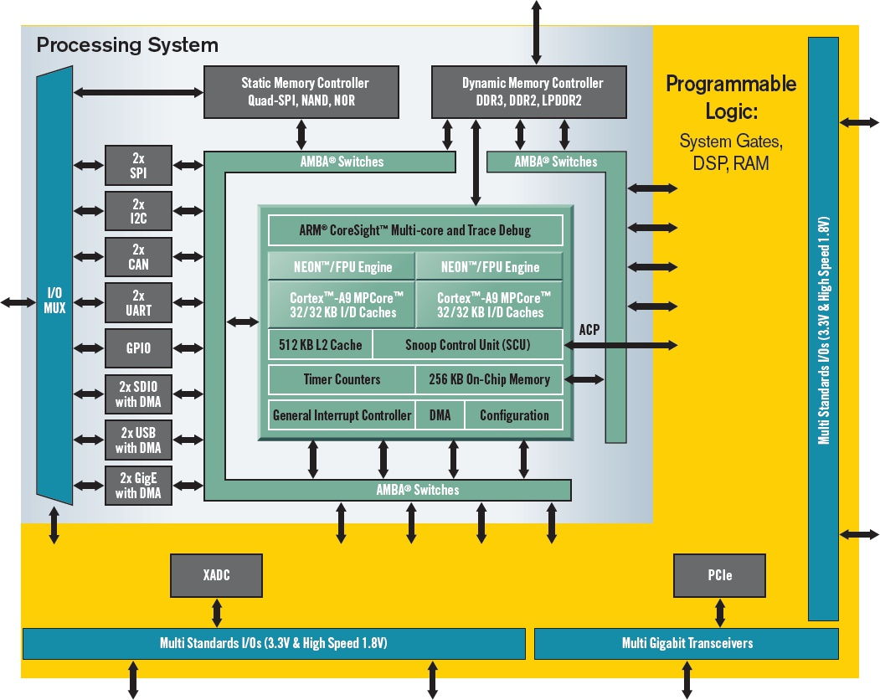
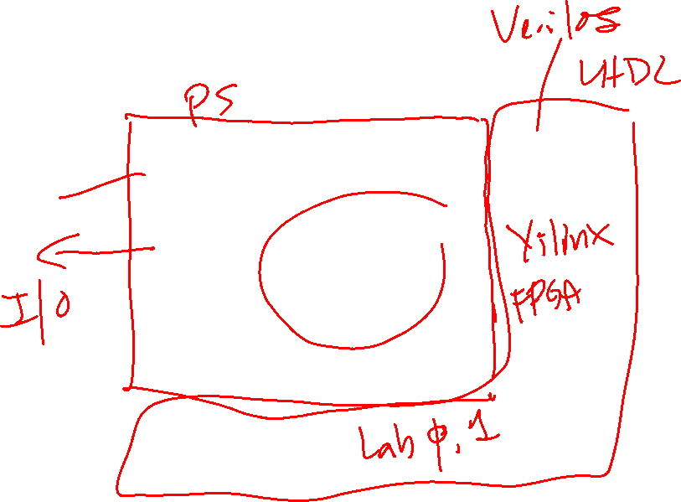
Mapping of an Embedded SoC Hardware Architecture to Zynq
The yellow area is FPGA area for Xilinx FPGA
Two ARM CPU cores
Xilinx: Creating the Xilinx Zynq-7000 Extensible Processing Platform
© Copyright 2014 Xilinx
Notes:
Figure 1. Unlike previous chips that combine MPUs in an FPGA fabric, Xilinx’s new Zynq-7000 Extensible Processing Platform device family lets the ARM processor, rather than the programmable logic, run the show.

Slide 12
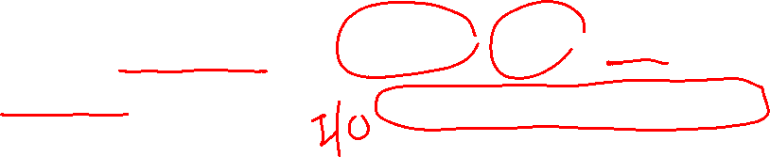
Field Programmable Gary Array (FPGA) - Generic Structure
Programmable logic blocks
Implement combinatorial and sequential logic
Programmable interconnect Wires
to connect inputs and outputs to logic blocks
Programmable I/O blocks
Special logic blocks at the periphery of device for external connections
Logic block
Interconnection switches
I/O
I/O
I/O
I/O

Slide 13
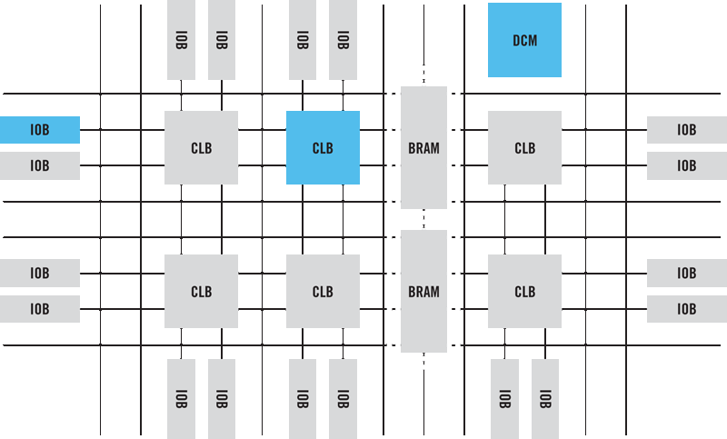

FPGA - Generic Structure
IOB – I/O Block
CLB – Configurable Logic Block
BRAM – Block RAM
DCM – Digital Clock Manager

Slide 14
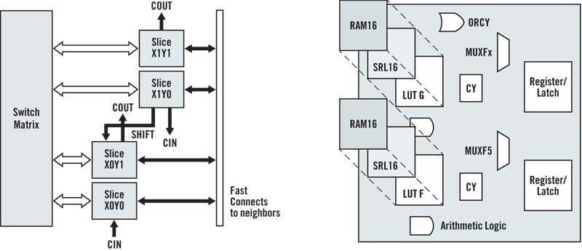
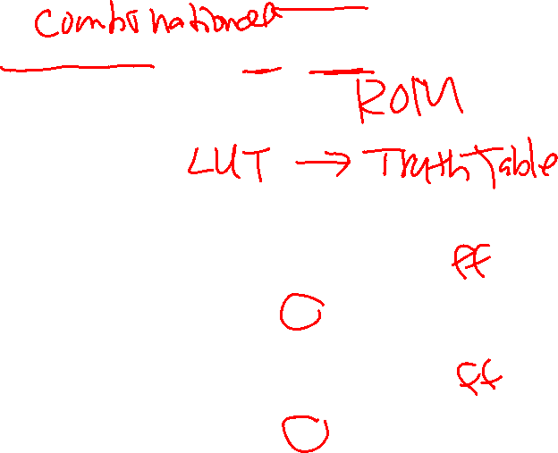
Configurable Logic Blocks (CLBs)
Each slice may have look-up tables (LUTs), RAM, flip-flops etc.
LUTs work like ROMs to implement truth tables
Slices are connected by Switch matrix
Notes:
The CLB is the basic logic unit in a FPGA. Exact numbers and features vary from device to device, but every CLB consists of a configurable switch matrix with 4 or 6 inputs, some selection circuitry (MUX, etc), and flip-flops. The switch matrix is highly flexible and can be configured to handle combinatorial logic, shift registers or RAM. More architectural details can be found in the applicable device’s data sheet.

Slide 15
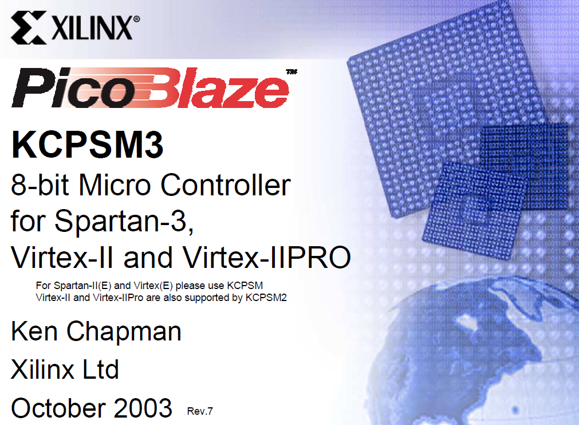



Slide 16
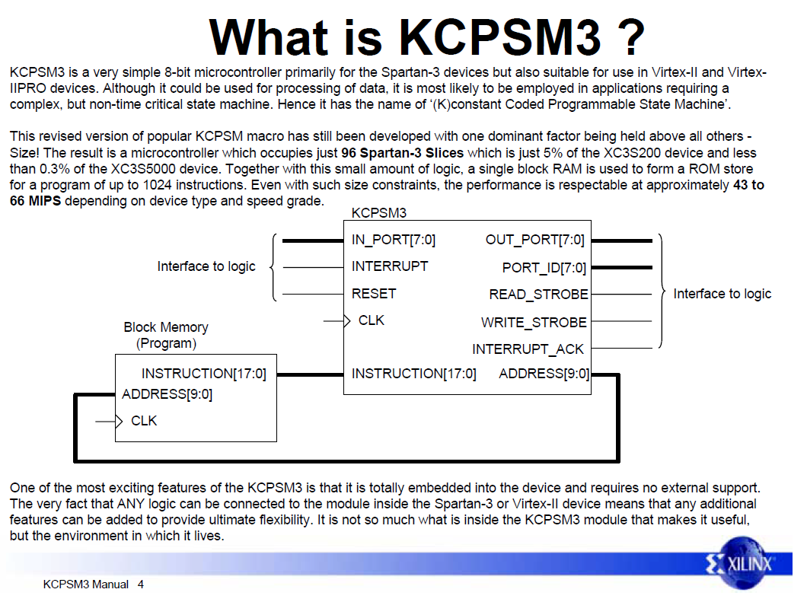
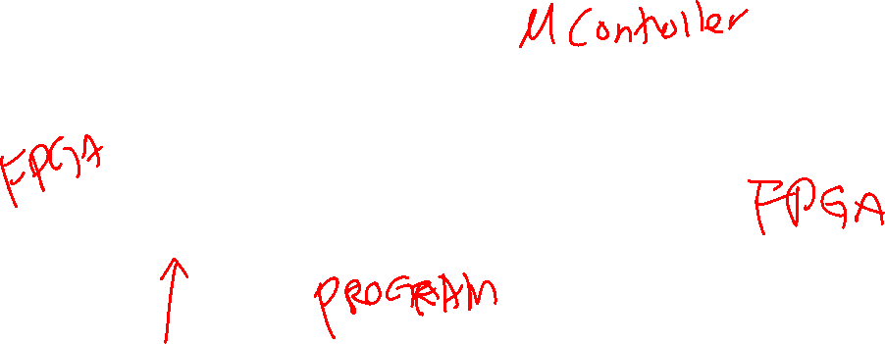


Slide 17

PicoBlaze Overview (8-bit Microcontroller)
PicoBlaze is a simple 8-bit microcontroller on FPGA
Compact in size
Occupies 96 slices in a Spartan-3 (5% of an XC3S200)
Performance is respectable to approximately 43 to 66 MIPs depending upon device and speed grade
Over 49 instructions
All instructions under all conditions will execute over 2 clock cycles
Supports a program up to a length of 1024 instructions using one Block RAM

Slide 18
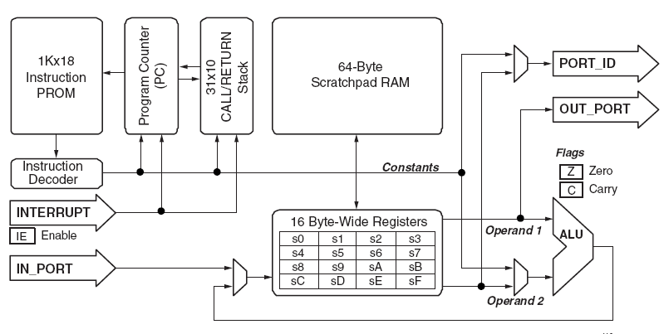

PicoBlaze Architecture
Register-based CPU, Harvard architecture

Slide 19
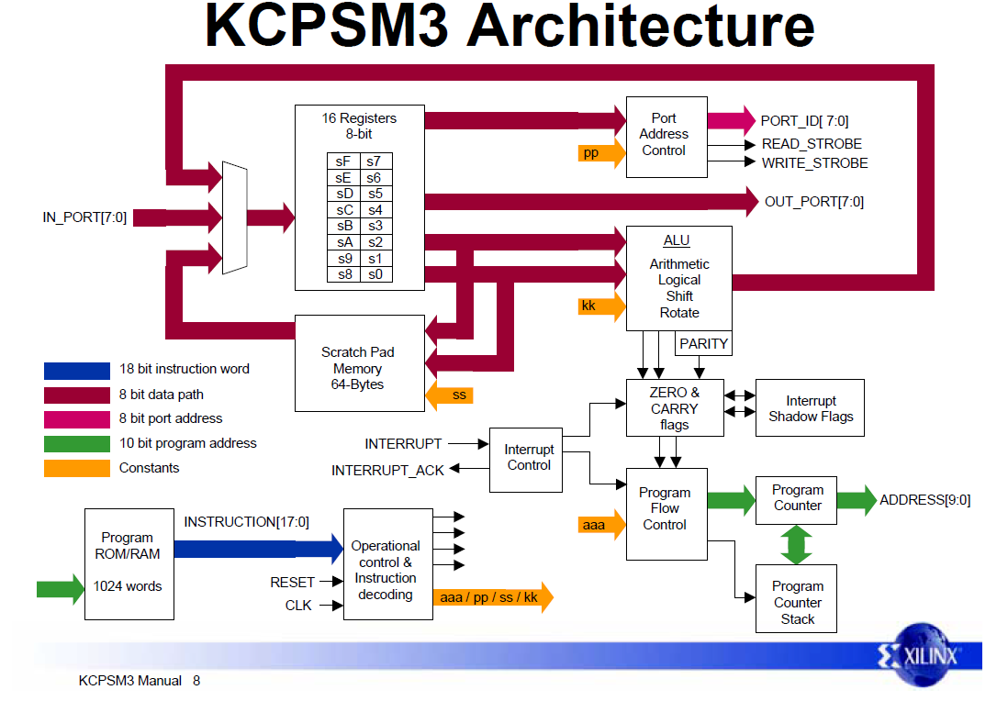

Detailed Architecture
Register-based CPU, Harvard architecture

Slide 20
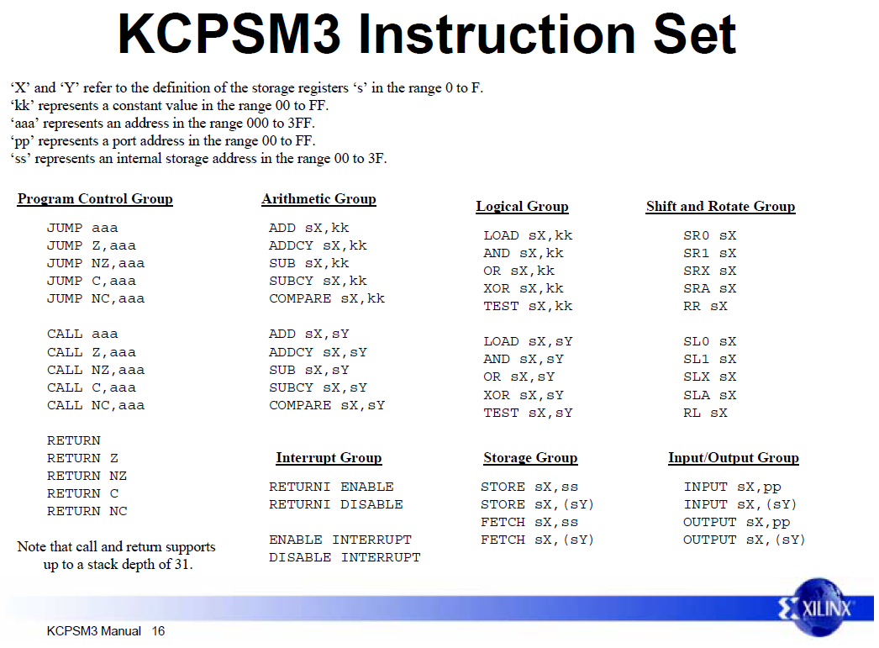
Instruction Set (Reduced Instruction Set Computer, RISC)

Slide 21
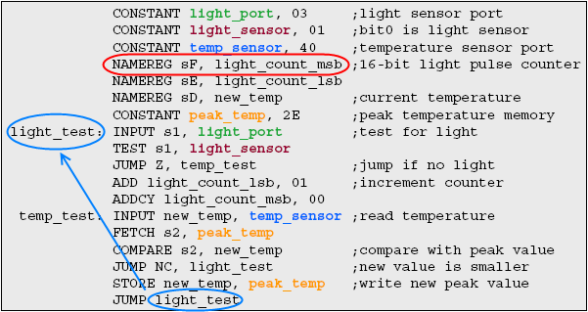
Assembly Code Snippet

Slide 22
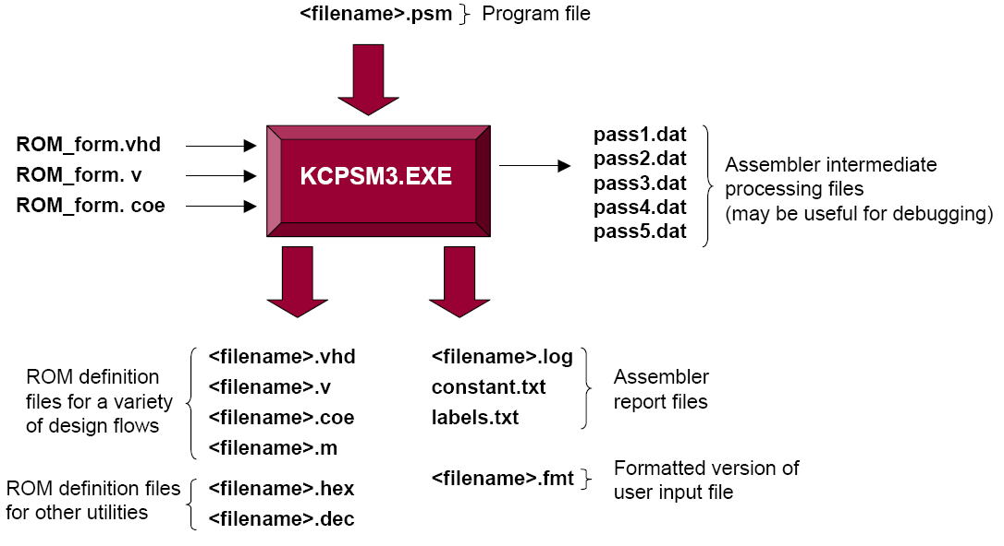
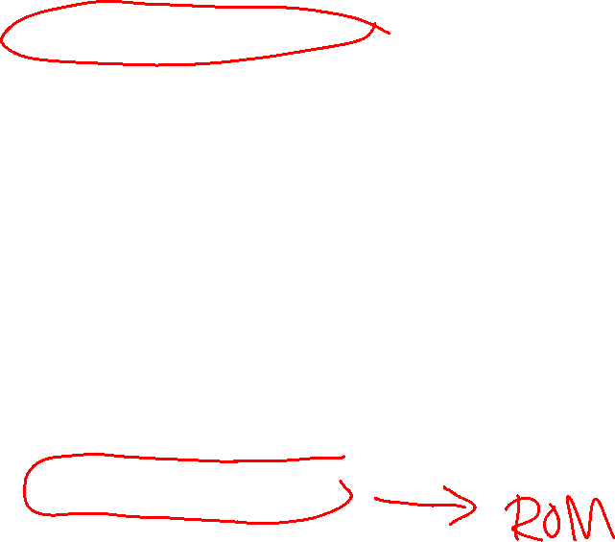
PicoBlaze Assembler
Not available for 64-bit Windows

Slide 23

Lab #1 Part 1: PicoBlaze Hardware Design
Add peripherals to the CPU in Verilog
Add circuits to capture info
Displays pattern
Generated in SW App
In_port
out_port[7:0]
waveforms
PicoBlaze
port_id[7:0]
D Q
en
interrupt
port_id[1]
write_strobe
Interrupt_ack
counter
Instructions
D Q
en
Address
port_id[2]
Instruction
ROM
Attach instruction ROM
Displays count value
Of SW interrupt counter
Interrupt_event
control
User generates interrupts externally

Slide 24
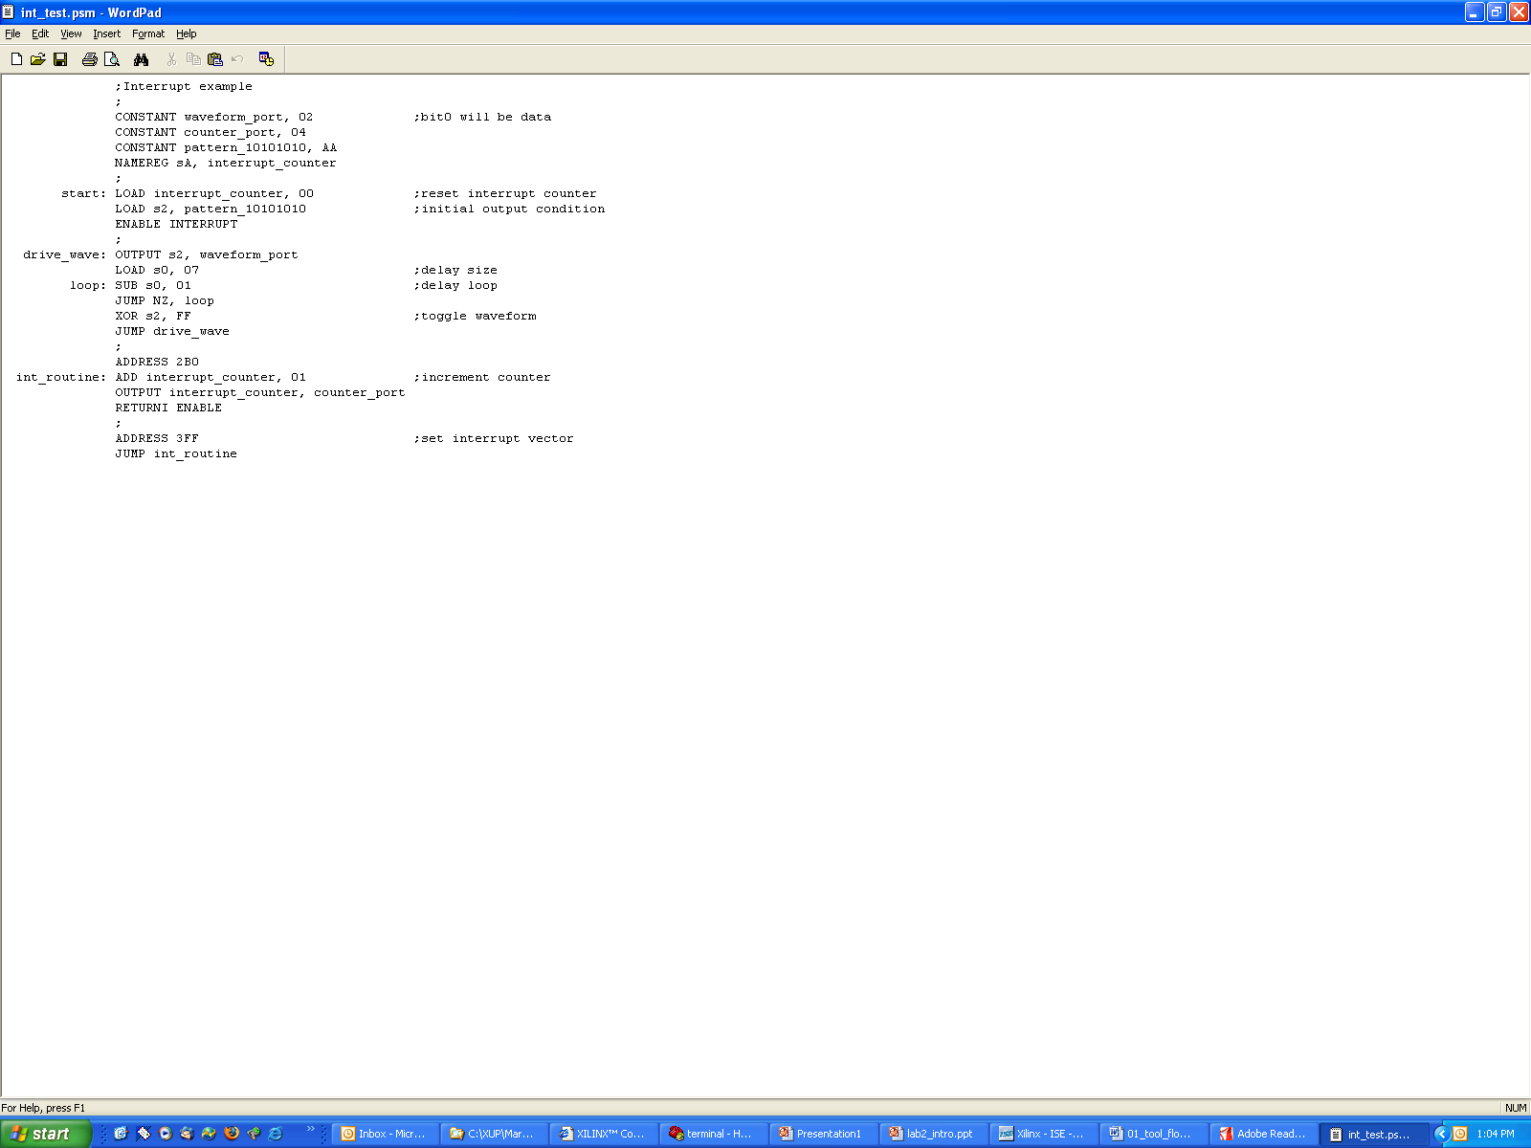
PicoBlaze Software Application
Initialize counter
And setup pattern
Repeatedly output
Pattern on wave
output port
counts number of
Interrupts and output
To counter output port

Slide 25
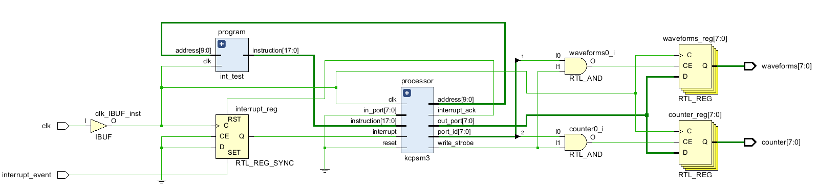
LAB #1 Part 1: Schematic of kcpsm3_int_test
kcpsm3 – 8-bit PicoBlaze CPU
int_test – Program (instructions) ROM, generated by an assembler
waveforms_reg - Displays pattern Generated in SW App
counter_reg - Displays count value of SW interrupt counter
The registers are selected by port_id
The registers are updated by write_strobe

Slide 26
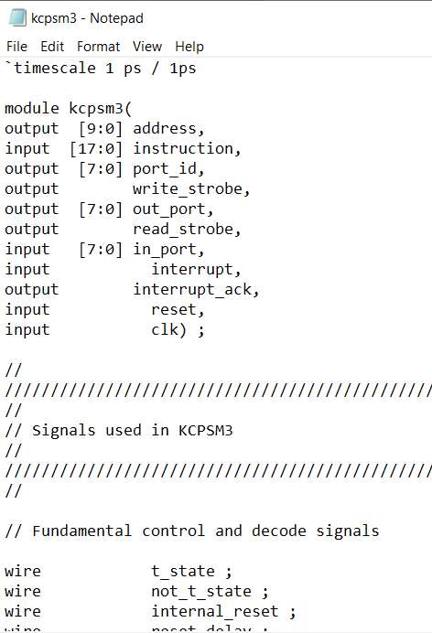
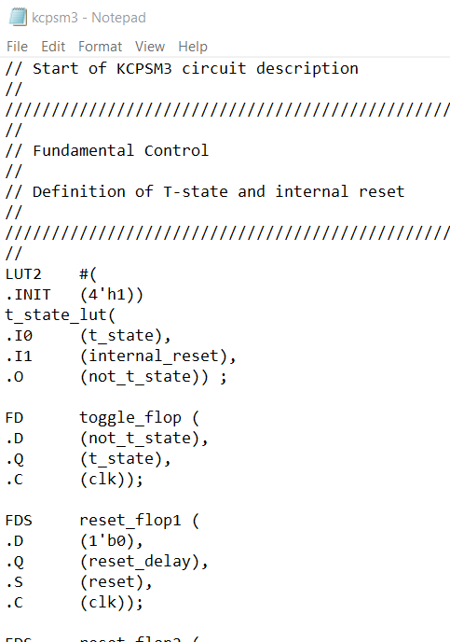

kcpsm3 – 8-bit PicoBlaze CPU in Verilog

Slide 27
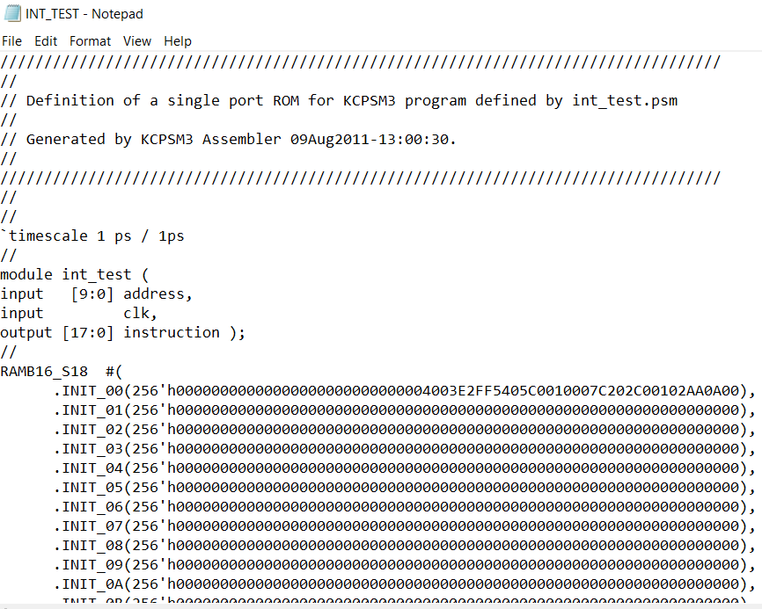
int_test – Program (instructions) ROM in Verilog

Slide 28
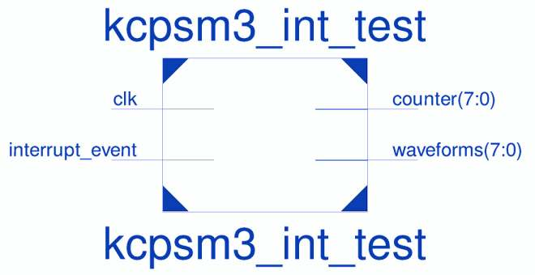
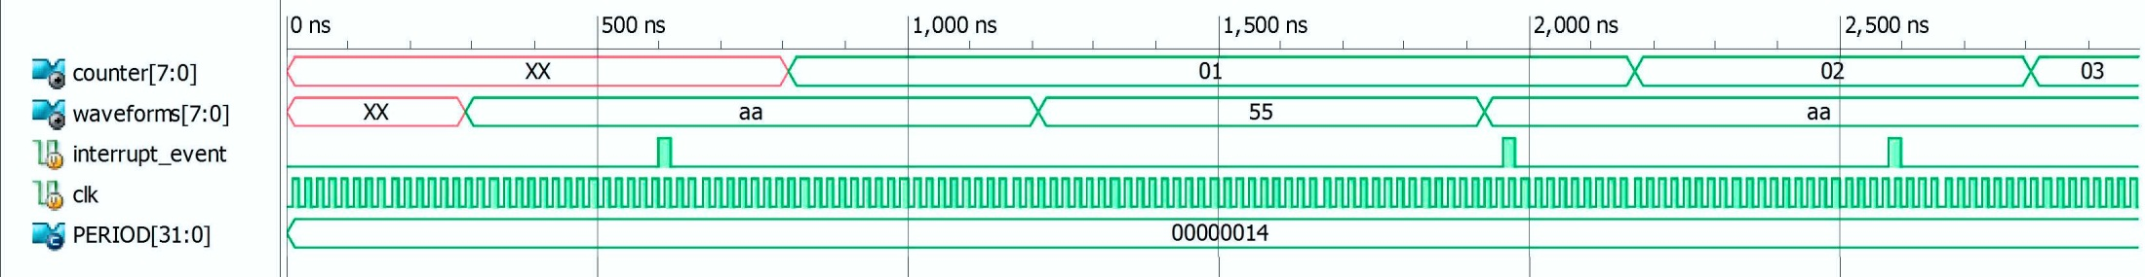
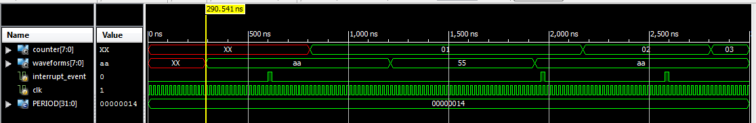

Simulation Waveforms
PERIOD is clock period in hexadecimal

Slide 29
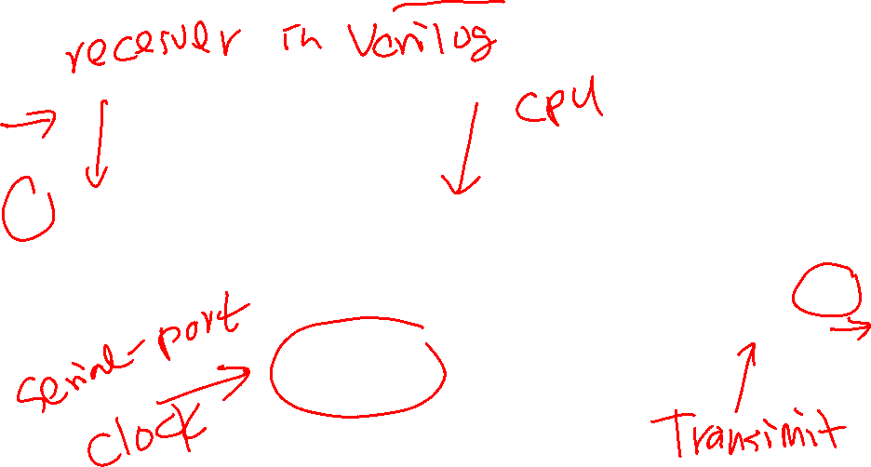
Lab #1 Part 2: PicoBlaze UART Clock Hardware Design
Baud Rate Clock Module
en_16_x_baud
Baud
Count
uart_rx
rx_data
D Q
en
PicoBlaze
out_port[7:0]
D Q
en
alarm
rx
000
interrupt
port_id[7:0]
rx_data
port_id[0]
rx_full
write_strobe
rx_half_full
Interrupt_ack
tx_full, tx_half_full
Instructions
uart_tx
tx
Instructions
Address
port_id[0]
Interrupt_event
control
UART

Slide 30
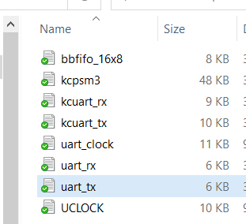

UART Real-Time Clock Files
bbfifo_16x8.v – 16-level 8-bit first-in-first-out (FIFO) buffer
kcpsm3.v – CPU
kcuart_rx.v – uart receive module
kcuart_tx.v – uart transmit module
uart_clock.v - top-level clock module
uart_rx.v – top-level uart receive module
uart_tx.v – top-level uart transmit module
UCLOCK.v – instruction ROM

Slide 31

UART Real-Time Clock
The design understands some simple ASCII commands
TIME – current time displayed according to 24 hour clock in format hh:mm:ss
TIME hh:mm:ss – allows time to be set according to 24 hour clock
ALARM – current alarm time will be displayed according to 24 hour clock. The current status of the alarm will be displayed (ON, OFF, Active)
ALARM hh:mm:ss – allows the alarm to be set according to the 24 hour clock. The new alarm time and current status will be displayed.
ALARM ON – Enables the alarm to be active. Current alarm time and status will be displayed.
ALARM OFF – Disables the alarm. Current alarm time and status will be displayed
Alarm LED is LD3 on Zybo
Clock Locked is LD0 on Zybo

Slide 32
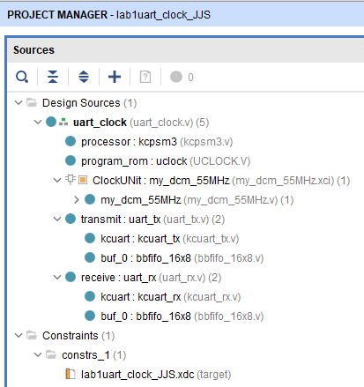
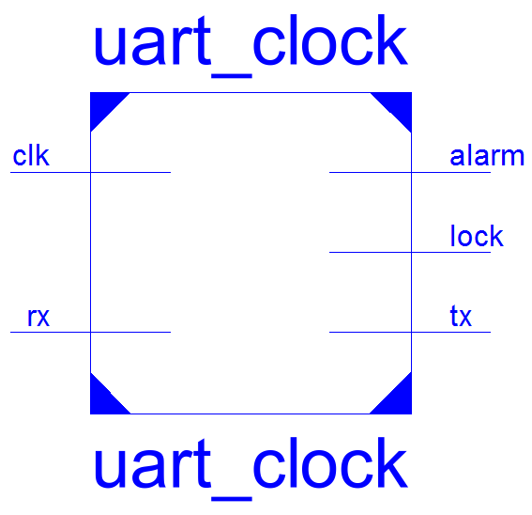
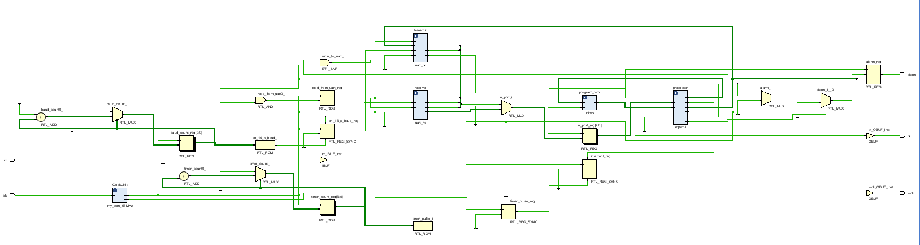

UART Real-Time Clock Schematic with Vivado
Internal System clock is 55MHz
UART Baud Rate is 38,400
lock shows system clock is normal
alarm shows time alarm status
clk is 125MHz on Zybo
rx and tx are receive & transmit of UART

Slide 33
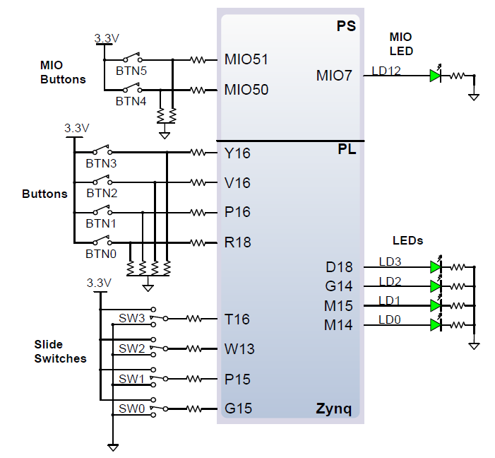
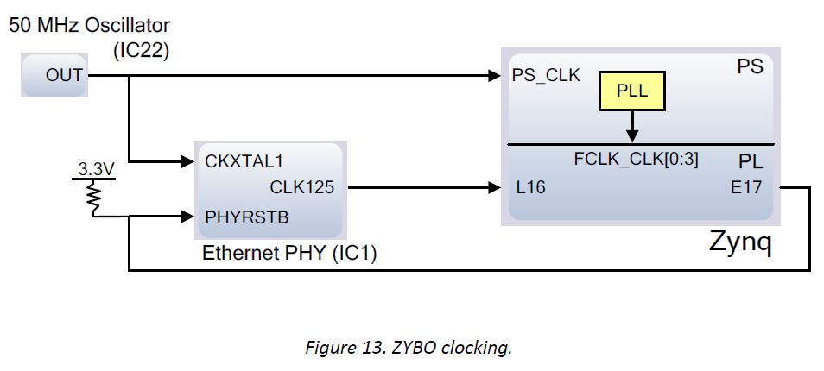
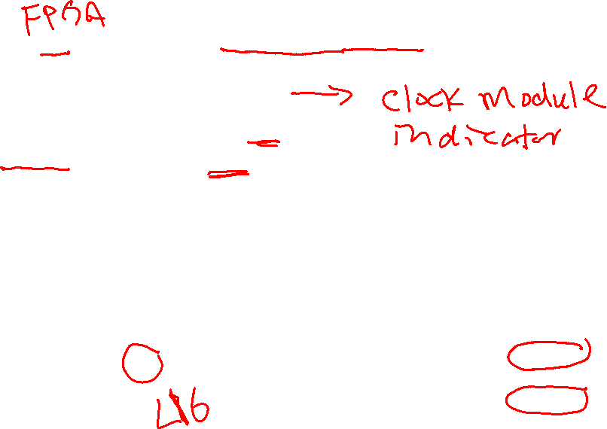
Clock and Basic I/O Devices on the Zybo Board
Zybo PL side uses an external 125MHz clock on pin L16. This is the clock source for the uart test circuit. The internal clock of 55MHz is generated by clock IP module
lock is connected to LD0 on pin M14
alarm is connected to LD3 on pin D18
rx and tx are connected to a Pmod connector
125MHz

Slide 34
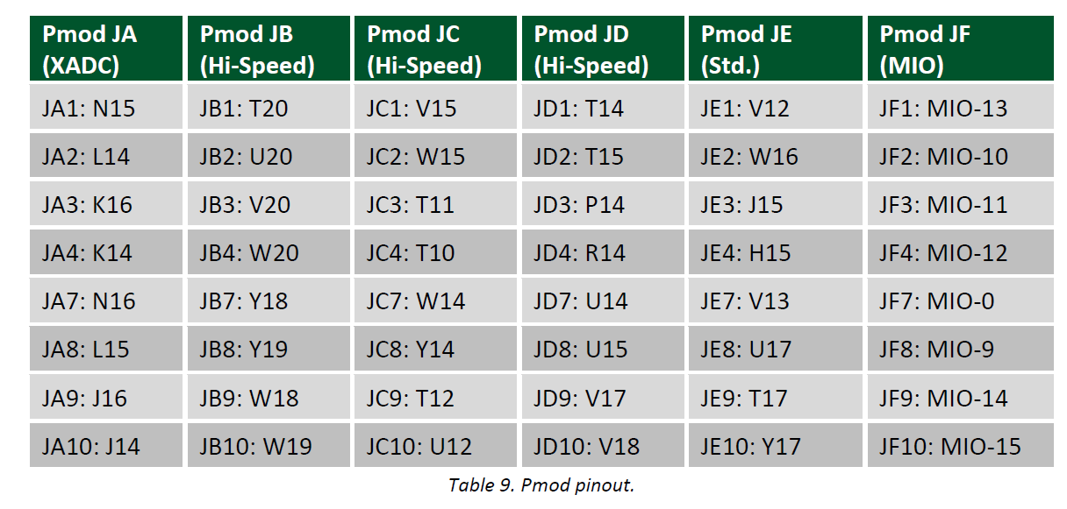
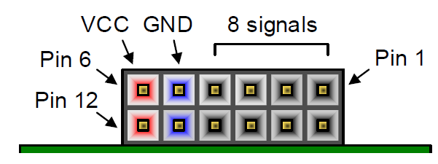

Pmod Connectors on the Zybo Board
Wire rx is connected to JB2 on pin U20
Wire tx is connected to JB1 on pin T20

Slide 35
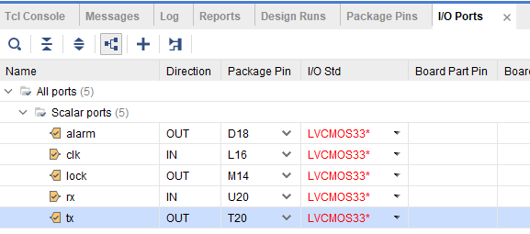
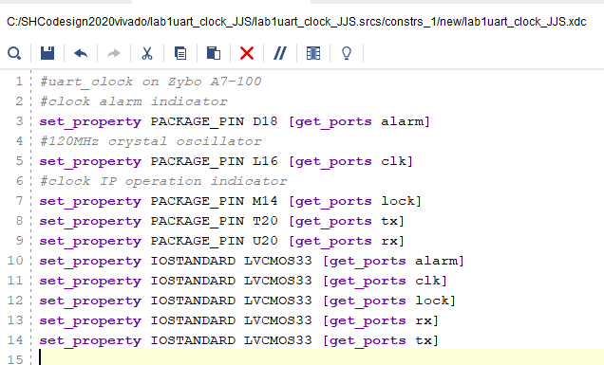
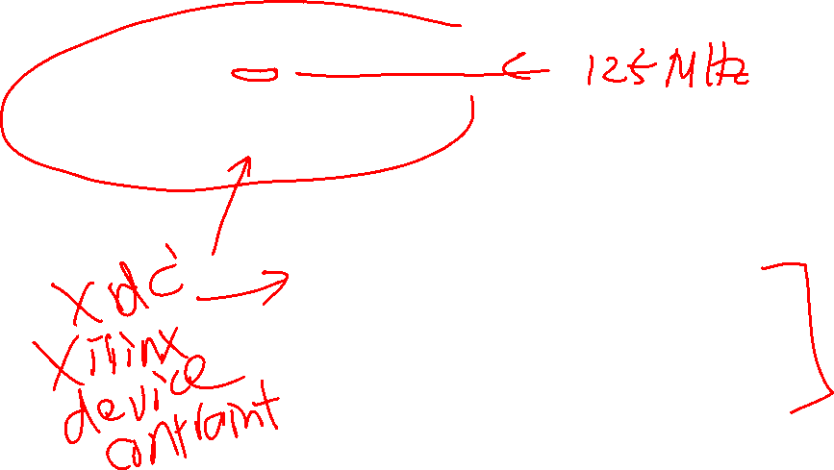
I/O Pin Assignment

Slide 36
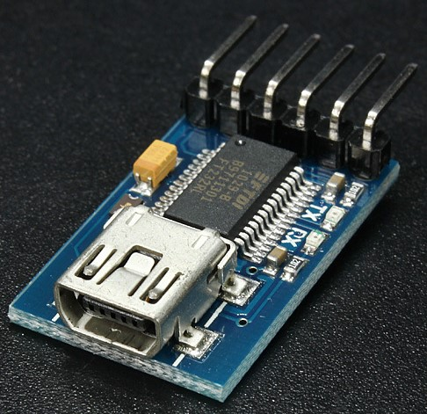
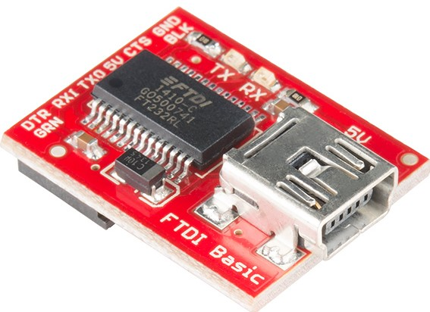


Red SparkFun FTDI Basic Breakout – 3.3V
https://www.sparkfun.com/products/9716. ($14.95)
Change voltage supply to 3.3V

Slide 37



Lab #1 Part 2: Pmod JB connection for UART

Slide 38


Implement uart_clock in Verilog with PL
Create a Vivado project, choose Zybo board
Add all Verilog circuit files to it
Under Sources, right click on Constraints to choose “Edit Constraints Set”
Add XDC file
Generate bit stream file
Open a serial terminal on your laptop
Connect the uart to USB adaptor to

Slide 39



Program Zybo with a bit stream file only
Choose “Program device”
Under Program and Debug
Click Hardware Manager
Do not click on open target. It may bomb.
Connect your Zybo board
Click Open Target->Auto Connect
Open hw_target messages will appear.

Slide 40



Implement uart in Verilog with PL
Click “Program Device”
Uncheck Debug probes file
The device is programmed

Slide 41


Device Manager and Com Port Numbers
Open Device Manager
Open Ports (COM &LPT)
See COM port numbers

Slide 42



Configuring a HyperTerminal Display
Start HyperTerminal for the first time
Enter Area code 812 and Cancel
Under Connection Description
Type com9b38400 to name a new connection
Set Properties
COM9
38400
8 bits
No parity
1 stop
No flow control

Slide 43




HyperTerminal Display: Alarm Clock
in ASCII Setup, enable “Append line feeds to incoming line ends
Baud = 38400, 8 bit data no parity, 1 bit stop, no flow control
Check “Append line feeds to Incoming line ends” in ASCII setup
PuTTY does seem to work.
File->Save as com15b38400 to save configuration
To load a configuration: File->Open com15b38400
Commands
Time to show time
alarm 00:00:40
alarm on/off
alarm to show alarm time

